Slide 1

Copyright © Cengage Learning. All rights reserved.

Slide 2

SECTION 9.5
Inequalities in Two Variables and Systems of Inequalities
Copyright © Cengage Learning. All rights reserved.

Slide 3
Graphing an Inequality

Slide 4

Graphing an Inequality
Two examples of inequalities in two variables are
2x + 3y > 6 and xy ≤ 1
A solution of an inequality in two variables is an ordered pair (x, y), with real coordinates, that satisfies the inequality.
For example, (–2, 4) is a solution of the first inequality
because 2(–2) + 3(4) > 6. The ordered pair (2, 1) is not a solution of the second inequality because (2)(1) 1.

Slide 5
Graphing an Inequality
The solution set of an inequality in two variables is the set of all ordered pairs, with real coordinates, that satisfy the inequality. The graph of an inequality is the graph of the solution set.
To sketch the graph of an inequality, first replace the inequality symbol with an equality sign and sketch the graph of the equation.
Use a dashed graph for < or > to indicate that the curve is not part of the solution set. Use a solid graph for ≤ or ≥ to show that the curve is part of the solution set.

Slide 6
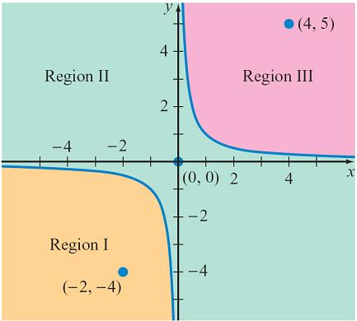
Graphing an Inequality
It is important to test an ordered pair in each region of the plane defined by the graph. If the ordered pair satisfies the inequality, shade that entire region.
Do this for each region into which the graph divides the plane. For example, consider the inequality xy ≥ 1.
Figure 9.19 shows the three regions
of the plane defined by this inequality.
Because the inequality is ≥, a solid
graph is used.
xy ≥ 1
Figure 9.19

Slide 7

Graphing an Inequality
Choose an ordered pair in each of the three regions and determine whether that ordered pair satisfies the inequality.
In Region I, choose a point, say (–2, –4). Because
(–2)(–4) ≥ 1, Region I is part of the solution set.
In Region II, choose a point, say (0, 0). Because 0  0 1, Region II is not part of the solution set.
In Region III, choose (4, 5). Because 4  5 ≥ 1, Region III is part of the solution set.
You may choose the coordinates of any point not on the graph of the equation as a test ordered pair; (0, 0) is usually a good choice.

Slide 8

Example 1 – Graph a Linear Inequality
Graph: 3x + 4y > 12
Solution:
Graph the line 3x + 4y = 12 using a dashed line.
Test the ordered pair (0, 0): 3(0) + 4(0) = 0 12
Because (0, 0) does not satisfy the inequality, do not shade this region.

Slide 9
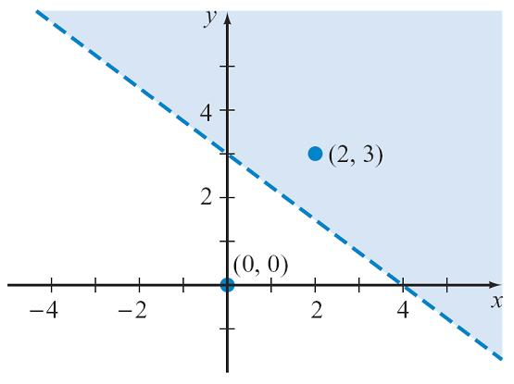
Example 1 – Solution
cont’d
Test the ordered pair (2, 3): 3(2) + 4(3) = 18 > 12
Because (2, 3) satisfies the inequality, the half-plane that includes (2, 3), shown in blue in Figure 9.20, is the solution set.
3x + 4y > 12
Figure 9.20

Slide 10
Graphing an Inequality
In general, the solution set of a linear inequality in two
variables will be one of the regions of the plane separated
by a line. Each region is called a half-plane.

Slide 11
Systems of Inequalities in Two Variables

Slide 12
Systems of Inequalities in Two Variables
The solution set of a system of inequalities is the
intersection of the solution sets of the individual
inequalities.
To graph the solution set of a system of inequalities, first graph the solution set of each inequality.
The solution set of the system of inequalities is the region
of the plane represented by the intersection of the shaded
regions.

Slide 13

Example 4 – Graph a System of Linear Inequalities
Graph the solution set of the system of inequalities.
3x – 2y > 6
2x – 5y ≤ 10
Solution:
Graph the line 3x – 2y = 6 using a dashed line.
Test the ordered pair (0, 0). Because 3(0) – 2(0) 6, (0, 0) does not belong to the solution set.
Do not shade the region that contains (0, 0).

Slide 14
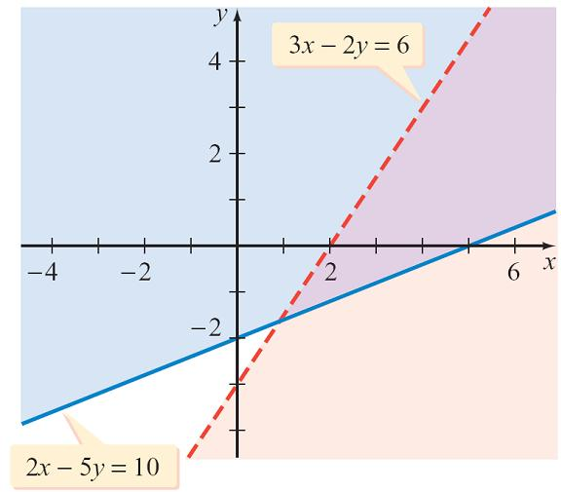
Example 4 – Solution
cont’d
Instead, shade the region below and to the right of the graph of 3x – 2y = 6, because any ordered pair from this region satisfies 3x – 2y > 6. See Figure 9.23.
Graph the line 2x – 5y = 10
using a solid line.
Test the ordered pair (0, 0).
Because 2(0) – 5(0) ≤ 10,
shade the region that contains
(0, 0). See Figure 9.23.
Figure 9.23

Slide 15
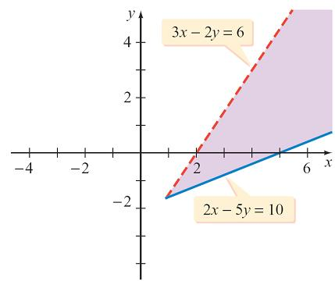
Example 4 – Solution
cont’d
The solution set is the region of the plane represented by the intersection of the solution sets of the individual inequalities. See Figure 9.24.
Figure 9.24

Slide 16
Nonlinear Systems of Inequalities

Slide 17

Example 6 – Graph a Nonlinear System of Inequalities
Graph the solution set of the system of inequalities.
x² – y² ≤ 9
x + 3y > 3
Solution:
Graph the hyperbola x² – y² = 9 by using a solid graph.
Test the ordered pair (0, 0). Because 0² – 0² ≤ 9, shade the region containing the origin.

Slide 18
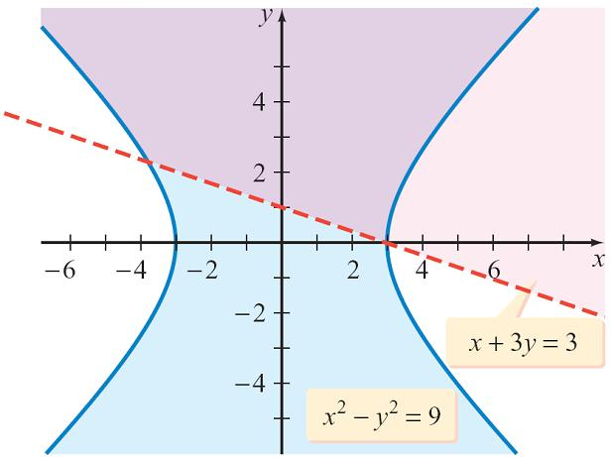
Example 6 – Solution
cont’d
By choosing points in the other regions, you should show that those regions are not part of the solution set. See Figure 9.26.
Graph the line x + 3y = 3 by
using a dashed graph.
Test the ordered pair (0, 0).
Because 0 + 3(0) 3, do
not shade the half-plane
below the dashed line.
Figure 9.26

Slide 19
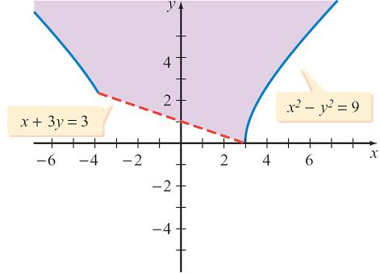
Example 6 – Solution
cont’d
Testing the ordered pair (4, 4) will show that we need to shade the half-plane above the line x + 3y = 3.
See Figure 9.26.
The solution set is the region
of the plane represented by the
intersection of the solution sets
of the individual inequalities.
This intersection is shown in
Figure 9.27.
Figure 9.27

